Slide 1

DriverPass System Analysis
Mike Garcia
Notes:
[No speaker notes required for this slide.]

Slide 2

System Requirements
The system shall provide the user access to online classes, practice tests, and on-the-road training depending on the package purchased.
The system shall provide administrators and staff access to higher privileges like modifying reservations for other users, downloading user logs, disabling packages, and resetting passwords.
The system is web-based and can be accessed from mobile or PC. It can be updated instantly when a reservation is made.
System admins like the IT admin should be able to make changes to users, like adding, removing, or modifying their privileges and roles, without changing code.
Notes:
The first point addresses that the system will support 3 different packages of services offered by DriverPass. Users will be provided different services based on which package they purchased, so they can receive the right amount of support they need to pass their driving test. The second point addresses the requirement of DriverPass distinguishing between different types of users. Staff such as secretaries and IT admins can do things that students don’t have access to, like make and modify reservations for other users, disable content on the website, and reset passwords for other users.
The system will be web-based and update instantly with user input, which is important because good performance is required for students to have accurate information on available appointment times and update DMV policies. The next point addresses accuracy and precision in defining specific roles for each type of user and controlling what resources they have access to. This accuracy is important for security reasons and for providing accurate information on the website. For example, only DriverPass’s owner and admins can make changes to site content and which packages are offered, which is important for DriverPass to accurately display updated DMV policies and show what services they provide.

Slide 3
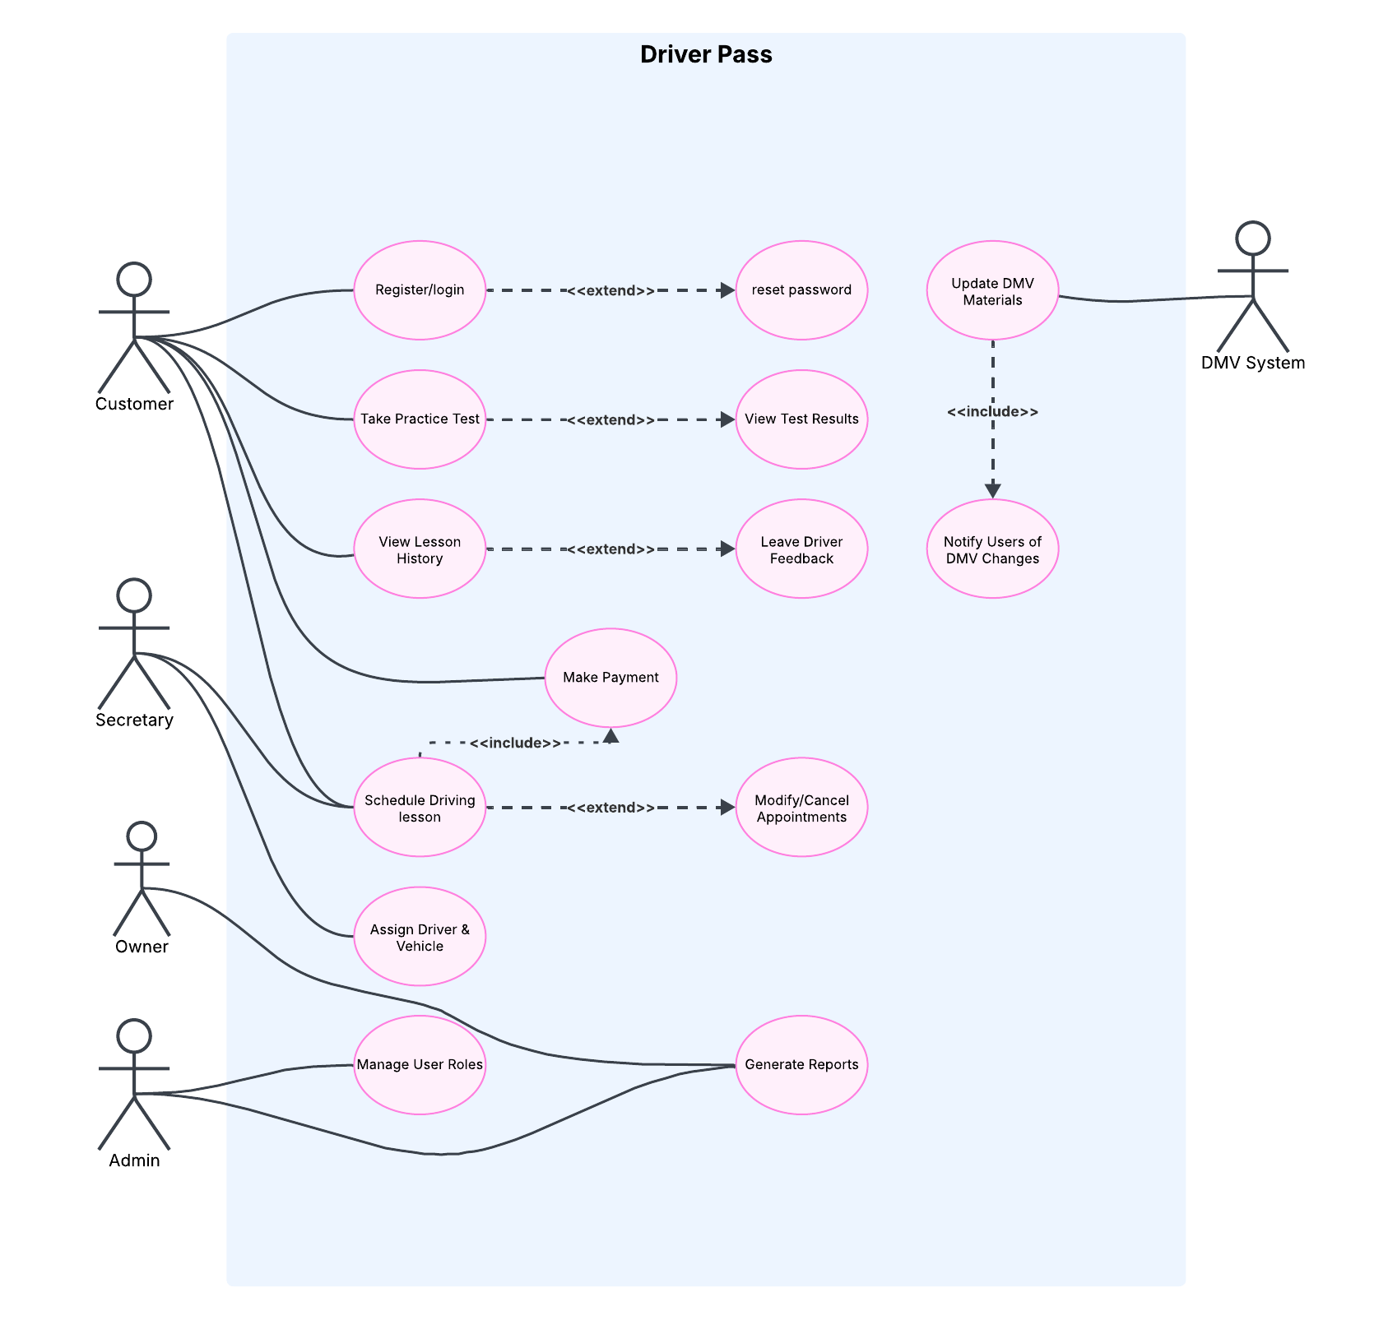
Use Case Diagram
Notes:
This diagram shows the different people who could be using the DriverPass system and how they would use it. This is important for identifying who is going to be using DriverPass and what activities each kind of user will participate in, which breaks down what kind of roles and functionality DriverPass needs to support. The different types of users would be the customer, which is a student trying to pass their driving exam, DriverPass’s owner, the admin, a secretary, and the DMV system, which could be a DriverPass staff member responsible for monitoring the DMV website for updates or a program written to monitor the site for updates. Each user interacts with the DriverPass system in a different way.
The customer or student can register for an account or login and can reset their password if they forget. They can also take practice tests and view lesson history from classes offered by the DriverPass system. The “extend” key word means that the behavior is optional to the original text bubble, so viewing results of a practice test after taking a practice test and leaving driver feedback after viewing lesson history are both options for the user, but not required actions. The student can also make a payment for purchasing a DriverPass package or schedule a driving lesson.
The secretary, like the student, can also schedule a driving lesson, but only the secretary can assign a driver and vehicle to a lesson. Scheduling a driving lesson is connected to the “make payment” action with a “include” key word, which means that the behavior is required, not optional, to the original text bubble, so scheduling a driving lesson must always follow with making a payment for the lesson. Both secretaries and student users can perform these actions.
The admin and owner can both generate reports, which are generated from recorded user activity on the site. Only the admin can manage user roles, which would include actions like assigning new employees to an admin or secretary role so they can perform their job duties, or removing those roles once an employee leaves the company.
The DMV system is the final user in this system and is very important to DriverPass providing the most accurate and up-to-date materials for their classes and lessons. They are responsible for updating DMV materials, like updated rules and policies, then notifying DriverPass users of these policy changes.

Slide 4
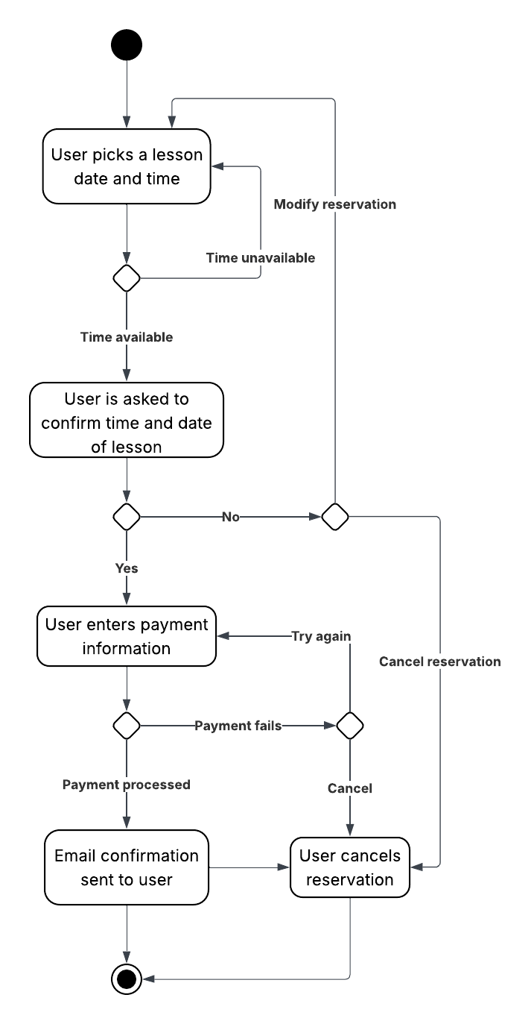
Activity Diagram
Notes:
This activity diagram breaks down the action of making a reservation for on-the-road training or an in-person lesson, which either a student user or a secretary can do. Breaking down the steps involved in each activity supported by the system like this allows us to clearly map out what pages need to be created so that we can provide an experience like this. Starting from the top dot and following the directions of the arrows, the first step is for the user to pick a lesson date and time. After that step, they will be notified whether the time is available or unavailable. If the time is unavailable, they will be redirected to the first step to choose another date and time. If the time is available, they will be asked to confirm that the time works for them. If they respond no, they’ll be given the option to modify the reservation to choose a different time that works for them, or cancel the reservation. Choosing to modify the reservation takes them back to the first step of picking a lesson date and time. Choosing to cancel takes them to the end of this activity, shown by the circle black dot. If the user responds yes, that they are available for their selected time and date, the system will prompt them to enter payment information, such as a credit card number or PayPal account. If the payment fails, they either try again and are directed to enter or correct payment information, or they choose to cancel the reservation which would take them to the end of this activity. If the payment processes successfully, the user will be sent an email confirmation of the appointment which ends this activity.

Slide 5
Security
All users are required to create a username and password to log in.
Accounts have basic protections like two-factor authentication, password recovery options, and account lockout.
The connection between the users and the main server is secured with standard communication protocols like HTTPS.
The building that the servers supporting DriverPass are located in is locked and secured.
Notes:
All users types, including staff members, are required to create their own username and password to log in. This allows users to be assigned roles so they can only have access to parts of the system that they need. Each account will have basic password protections, like optional two-factor authentication, which requires a second way of logging in after using your password to log in, such as being texted an additional code to enter. Password recovery options are for users who forget their password or have too many password attempts, which protects against someone trying to hack into a user’s account by guessing their password. The user will be prompted to enter the email associated with their account where they will be emailed a link to reset their password.
The data that is sent from the user to the main server, like their login information, account information, and payment information, will be secured with communication protocols that are commonly used in the industry, like HTTPS.
The building that houses the servers will always be locked and can only be unlocked by staff members that have a key or ID card required for entry. The building will also have an alarm system to automatically alert police if someone attempts to break in.

Slide 6
System Limitations
The system will not work if wherever the server is hosted suffers an internet or power outage.
More complicated updates to the system like updating class material or changing the packages that are offered require a software developer to be on staff.
Notes:
As the first point states, the system is web-based and requires the servers to be running 24/7 to constantly provide access to DriverPass. An internet or power outage would prevent users from having access to DriverPass until those services are brought back up. There are ways this can be mitigated by maintaining a backup generator in the building and maintaining backup servers that back up data every day, so that after an outage everything can be brought back up. The final limitation is that more complicated updates would require a software developer on staff, which would be a significant additional cost to DriverPass. For now, we can simply allow DriverPass to remove packages or lessons they no longer want to provide, but adding those would be a complicated process that would require a software developer.

